Slide 1
Senior Swordplay

Slide 2
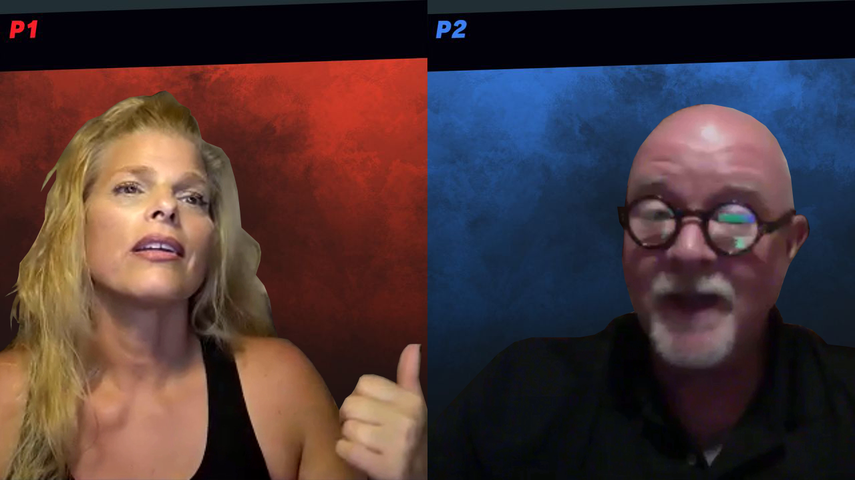
CHARACTER BREAKDOWN
Female
A PhD psychologist
Any ethnicity
50s
Male
A welder
Any ethnicity
50s

Slide 3



SYNOPSIS
After Maeve and Rob meet through an online dating site, this seemingly mismatched PhD psychologist and blue-collar welder have their first real date. They promptly begin a provocative and sensual journey of discovery to learn to what extent they might, or might not, be compatible and suited for a long-term relationship.

Slide 4

Development history
First Draft Program
Online Reading

Slide 5
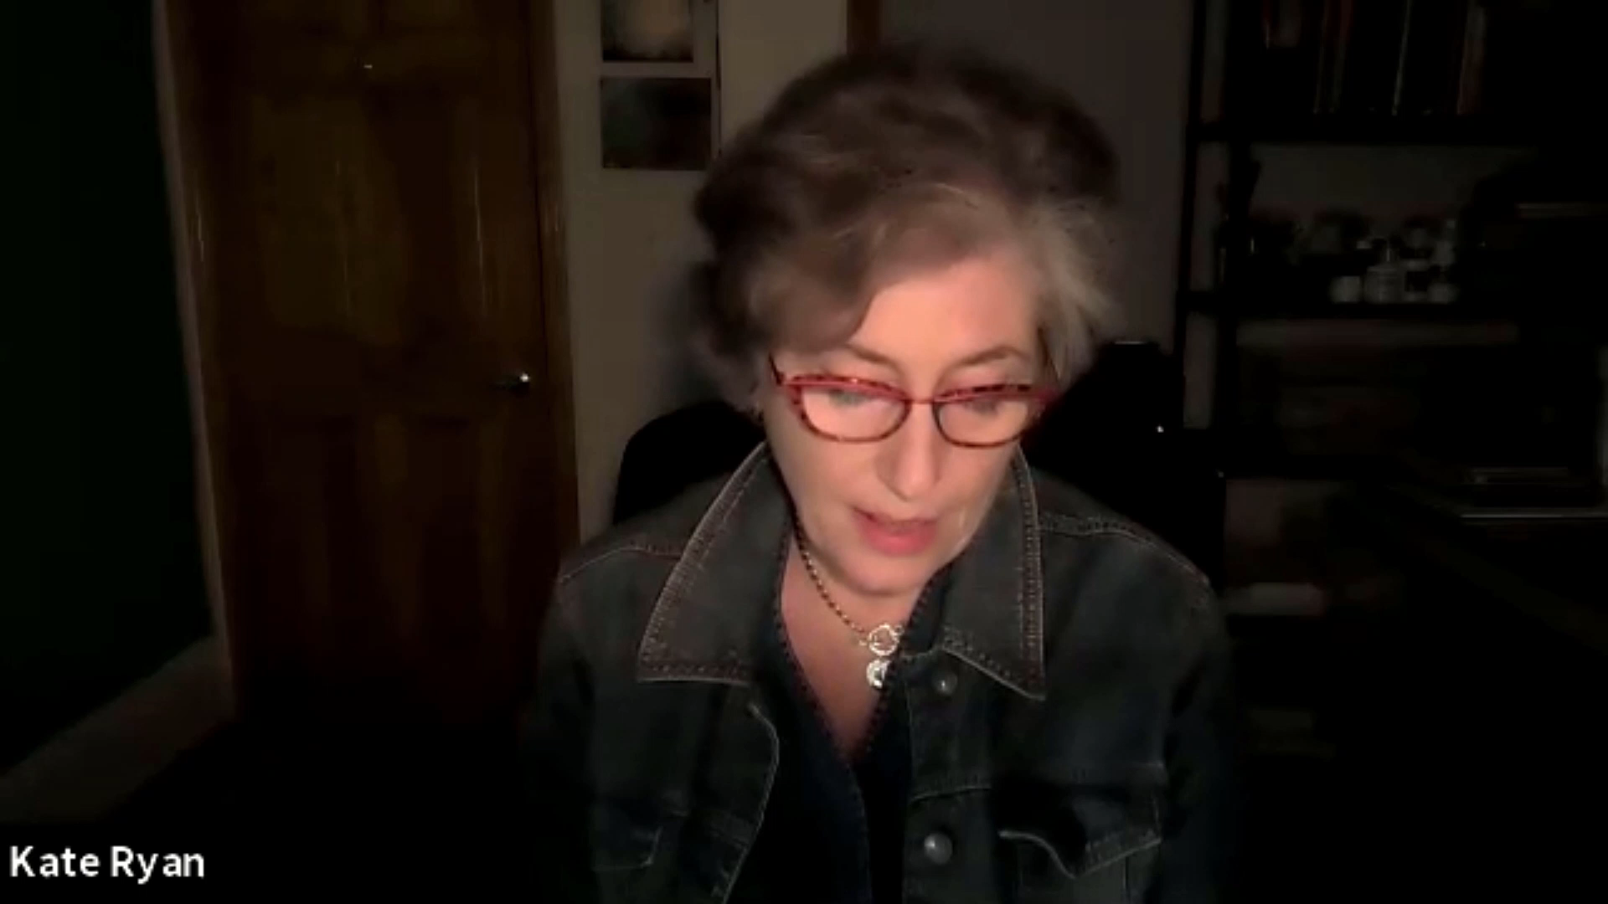

Slide 6
REVIEWS
“Ruyle's Senior Swordplay is so private and intimate that you can't help but feel like a voyeur reading it. The characters are raw, vulnerable and fully exposed, both emotionally and physically. Exceptional dialogue and expert storytelling, filled with unique and surprising moments and culminating in a powerful ending brimming with emotion and a hint of hope.”
Craig Houk
Award-Winning Playwright
Well-crafted realistic characters, superbly written dialogue, tasty conflict and a hopeful finish - what more could you want in a play? Nothing, I say! Ruyle taps into human experience like an expert, and the result is a gift to any audience. Produce!
Vivian Lermond
Award-Winning Playwright

Slide 7
Development GOALS

